Slide 1

Satan’s
If I Were
MINISTER
(part 5)

Slide 2



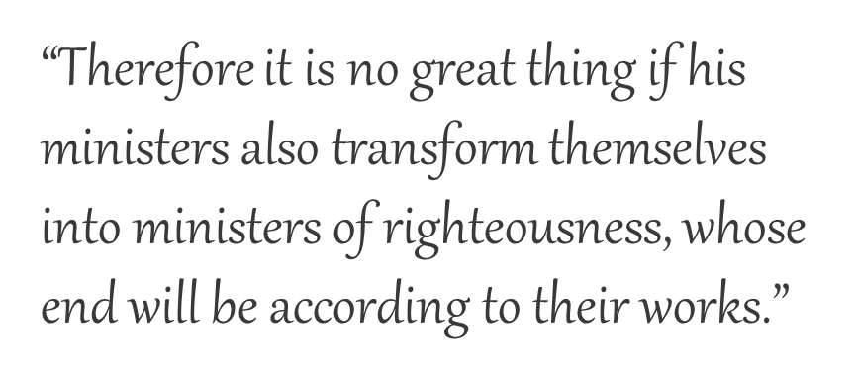
If I Were
SATAN’S MINISTER
2 Corinthians 11:15
I Would Embrace the Essentials of Calvinism:
“Wholly of grace”
“Salvation is all of God and none of me”
“Faith is a gift of God”
“Salvation is by faith alone”

Slide 3
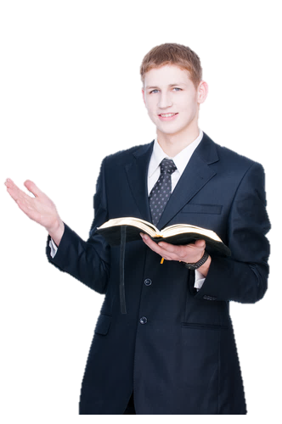

If I were Satan’s Minister…
“Salvation is not by any work but by faith alone.”
I would teach that justification is solely through faith.

Slide 4

NOT FAITH ALONE, BUT “FAITH THAT WORKS!”
James 2
“What does it profit, my brethren, if someone says he has faith but does not have works? Can faith save him?” (2:14)
Thus also faith by itself, if it does not have works, is dead” (2:17)
“ . . .‘You have faith, and I have works.’ Show me your faith without your works, and I will show you my faith by my works” (2:18)
“You believe that there is one God. You do well. Even the demons believe––and tremble!” (2:19)

Slide 5
NOT FAITH ALONE, BUT “FAITH THAT WORKS!”
James 2
“But do you want to know, O foolish man, that faith without works is dead?” (2:20)
“Was not Abraham our father justified by works when he offered Isaac his son on the altar?” (2:21)
“Do you see that faith was working together with his works, and by works faith was made perfect?” (2:22)
“You see then that a man is justified by works, and not by faith only” (2:24)

Slide 6
NOT WORKS ALONE, BUT “WORKS OF FAITH”
“But to him who does not work but believes on Him who justifies the ungodly, his faith is accounted for righteousness” (Rom. 4:5)

Slide 7
CONTRADICT OR COMPLIMENT?
“For if Abraham was justified by works, he has something to boast about, but not before God.”
IF PAUL TAUGHT THAT ABRAHAM WAS JUSTIFIED BY “FAITH ALONE,”
THEN HE CONTRADICTS WHAT JAMES TAUGHT
Romans 4:2
Was not Abraham our father justified by works when he offered Isaac his son on the altar?
James 2:21

Slide 8
WORKS
WITHOUT FAITH
DO NOT JUSTIFY!
COMPLIMENTARY
ONLY ‘WORKS’ OF ‘FAITH’ JUSTIFY!
FAITH
WITHOUT WORKS
DOES NOT JUSTIFY!

Slide 9
IF PAUL TAUGHT
“JUSTIFICATION” BY FAITH ALONE:
HE CONTRADICTED HIMSELF
“Who ‘will render to each one according to his deeds’: eternal life to those who by patient continuance in doing good…but to those who…obey unrighteousness—indignation…” (Rom. 2:6-8)
What did Paul incessantly remember (1 Thess. 1:2-4)?

Slide 10


GOD (1 TIM. 4:10)
REPENTANCE (ACTS 2:38)
JESUS (LK. 19:10)
CONFESS (ROM. 10:9)
WHICH WILL
YOU
EXCLUDE?
HOLY SPIRIT
(TITUS 3:5)
BAPTISM
(1 PET. 3:21)
GOSPEL
(ROM. 1:16)
HOPE (ROM. 8:24)
WORKS (JAS. 2:24)
BLOOD (1 PET. 1;18, 19)
YOU (1 TIM. 4:16)

Slide 11
If Faith Alone Saves?
Why are demons lost?
Why was the Scripture fulfilled when Abraham offered up Isaac (Jas. 2:23; Gen. 15:6)?
Why are those who believe given “a right” to become children of God (Jn. 1:11, 12)?
Why were some who believed in Him not saved (Jn. 12:42, 43)?
Why stop the chariot to baptize a believer (Acts 8:29-39; Mk. 16:15-16; Acts 2:38)?

